Slide 1
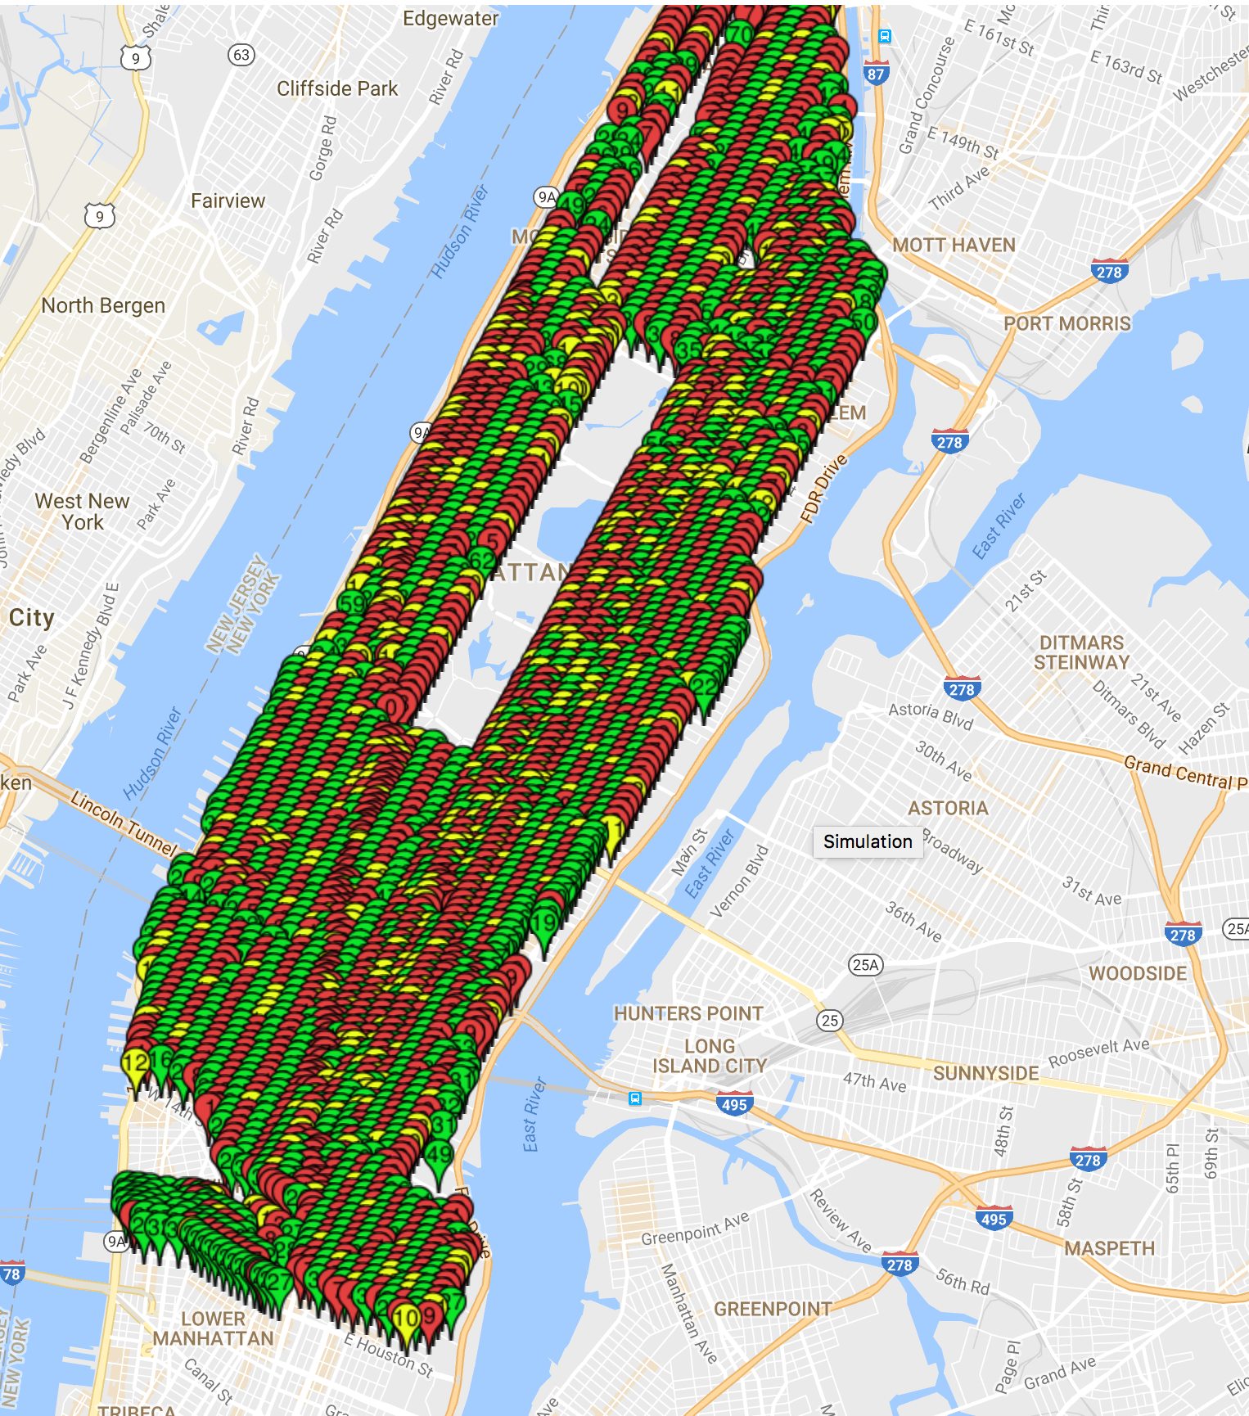
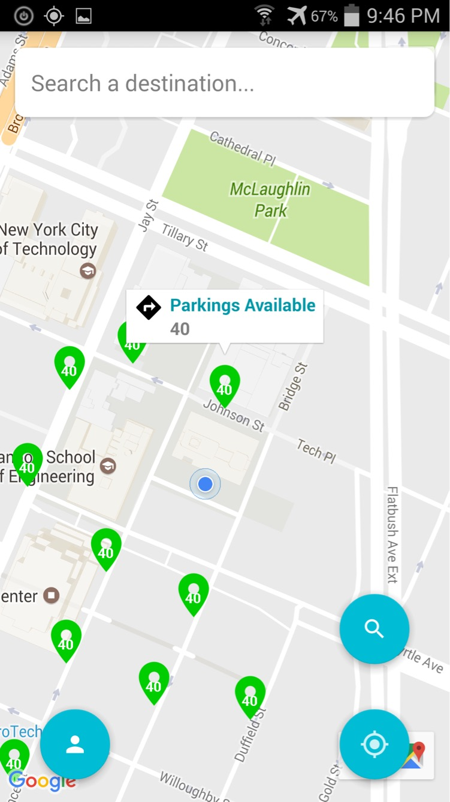
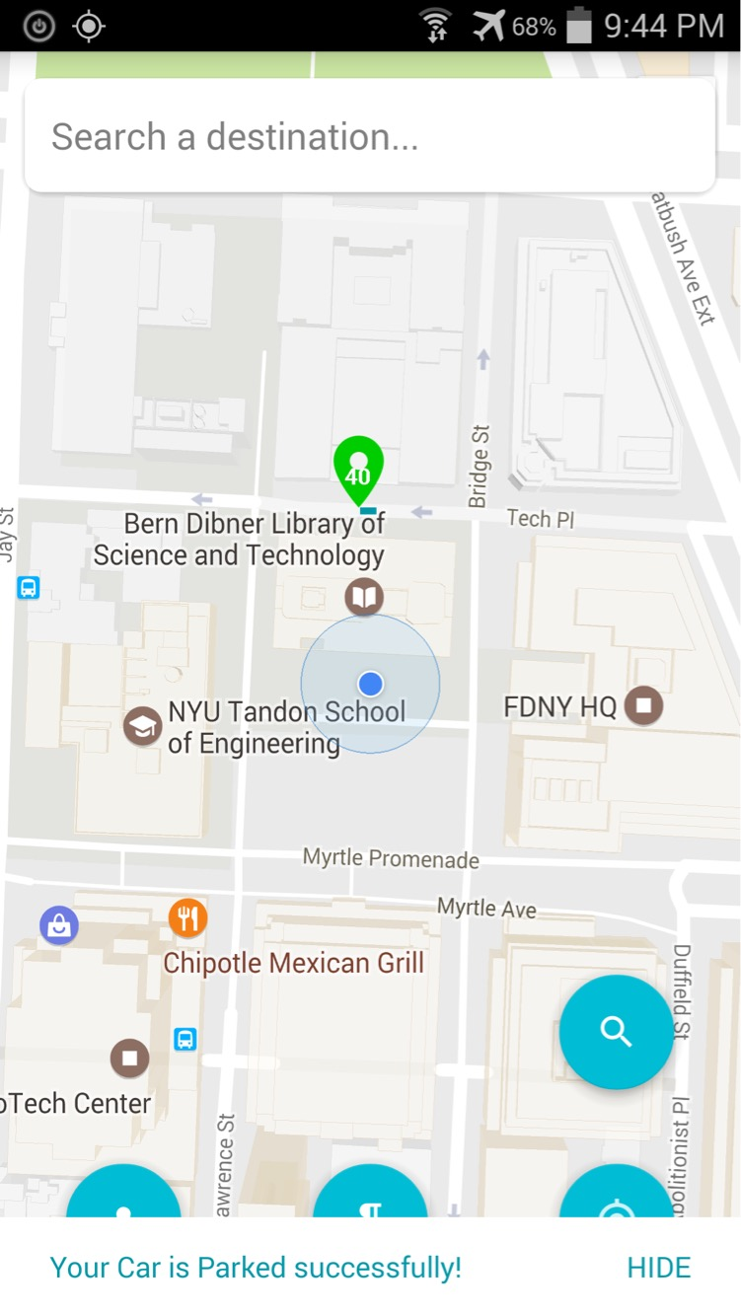
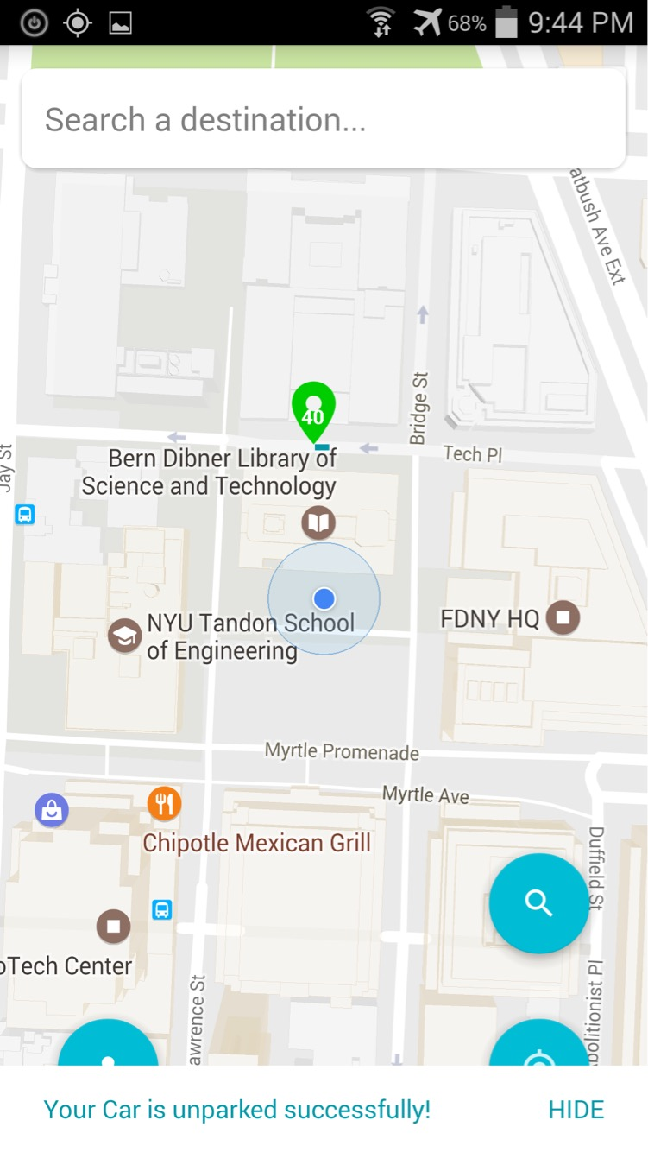
PARKING RECOMMENDATION SYSTEM
A system which finds and helps in notifying vacant street parking spots
Team: J. A. Y.
The architecture diagram is as shown above. The Web Server is scalable using Elastic Beanstalk. Coupled with Kafka the mobile makes an unblocking call to the app.
We have used MongoDB to store Geo Spatial data. It has a geospatial index which helps to get quires extremely fast for the nearby parking coordinates.
We have created our own data for Manhattan parking. The above diagram represents parking spots having number of parking spots on the markers.
Green indicates several parking spots are available in that block, yellow indicates fewer parking spots are available and red indicates very less spots are available.
This is our Web Monitoring tools which gets deployed with the App. We use this to simulate parking spots and test outputs.
When the user searches for parking spots he/she will get markers on a map showed in our application and the number of parking spots available.
This functionality has been decoupled with the app using Kafka for efficiency.
The user can click on the parking spot he/she likes and get a route to that spot.
The user parks the car at the spot selected. This information is passed to the server and the parking spot in the geospatial data is updated with this information.
Other uses will then see number of parking spots that is 1 less than it was previously.
Ultimately when the user will unpark he/she will press a button so that an vacant spot can be created again.
Other users then will be able to see this spot for parking.

